Slide 1





SUPERHERO U FACEBOOK AD CAMPAIGN ANALYSIS
Recommendations for Cost Optimization
Presented by: Maryam Farhan, Nahian Tasnim, Nidhi Ranjan, Onyinyechukwu Eze, Poornima Anamaneni Sayeeswaran, Riya S, Shriya Singh
1

Slide 2



TEAM INTRODUCTION
Shriya Singh
Onyinyechukwu Eze
Team Lead
Project Scribe
Poornima Anamaneni Sayeeswaran
Riya S
Nidhi Ranjan
Project Manager
Project Scribe
Project Lead
Nahian Tasnim
Maryam Farhan
Project Scribe
Project Lead
2

Slide 3

OBJECTIVES
Campaign Analysis
Analyze Facebook ad campaign data to identify at least one campaign for discontinuation.
Data Visualization
Provide clear, polished visualizations to support our recommendations.
Presentation Delivery
Deliver a comprehensive and engaging final presentation.
Optimization Strategy
Suggest actionable steps to enhance future ad campaign effectiveness.
3

Slide 4

WHAT IS SUPERHERO U?
Overview: A global competition by GlobalShala fostering innovation and creativity in youth.
Mission: Inspired by the UN's mission to promote prosperity and protect the planet.
Goal: Empower students to solve social issues using their skills and creativity.
Categories: High school and college students.
Timeline: August 2020 - April 2021 (Preliminary, Semi-final, Final rounds)
4

Slide 5

UNDERSTANDING FACEBOOK ADS
What are Facebook Ads?
Digital advertisements on Facebook, designed to reach target audiences using data-driven insights.
Why Use Facebook Ads?
Cost-effective, measurable results, and highly targeted marketing.
Key Metrics
Impressions, Click-Through Rate (CTR), Cost-Per-Click (CPC) .
5

Slide 6
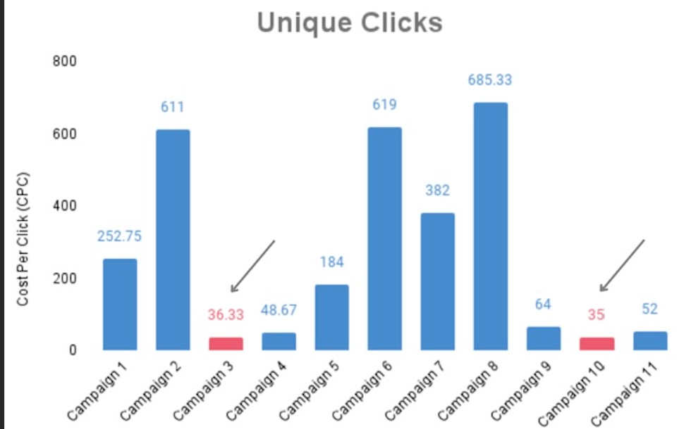

Recommendation for Campaign Discontinuation
(Analysis of Unique Clicks)
Campaign 3 (SHU_Students - Australia ) : 36.33 unique clicks.
Campaign 10 (SHU_Students - UK ) : 35 Unique Clicks.
Low Unique Clicks → ineffective audience reach.
Need for optimization or discontinuation.
6

Slide 7
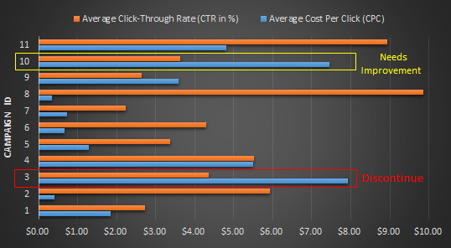
Recommendation for Campaign Discontinuation
(CPC vs. CTR)
High CPC and low CTR showcase poor audience engagement
Campaign 3: Highest CPC, average CTR (Discontinue)
Campaign 10: High CPC, average CTR (Needs Improvement)
7

Slide 8
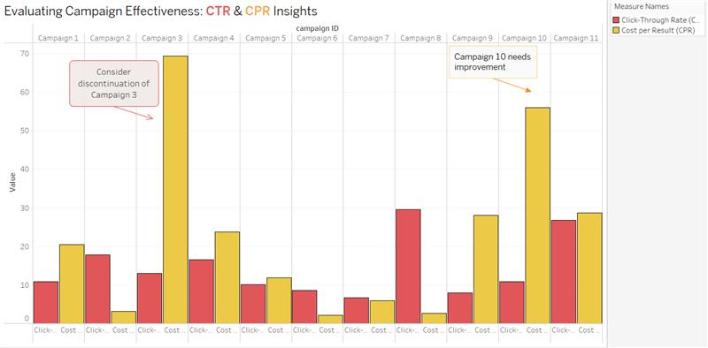

Recommendation for Campaign Discontinuation
(CTR vs. CPR)
Campaign 3: High CPR, low CTR → Consider discontinuation
Campaign 10: Moderate CTR, high CPR → Optimize (targeting, creatives, or bidding strategy)
8

Slide 9
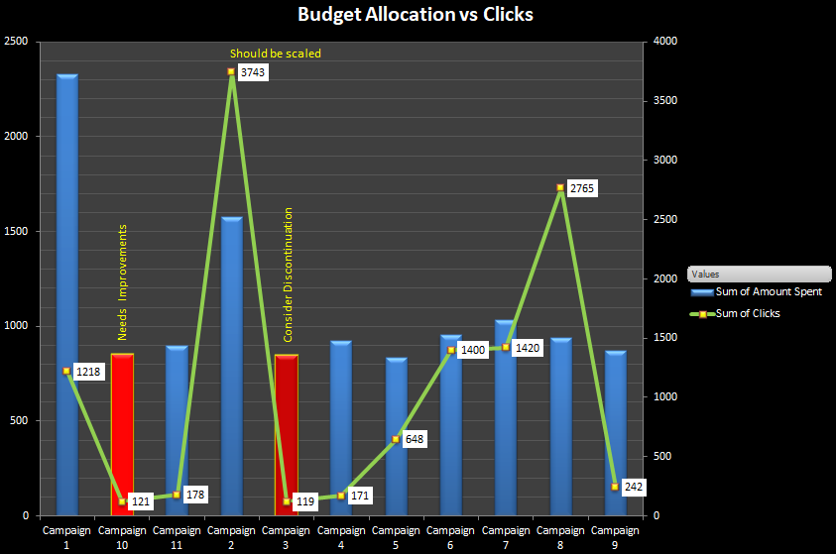
Recommendation for Campaign Discontinuation
(Budget Allocation (Amount Spent) vs. Clicks)
Campaign 3: High amount spent, but only 119 clicks
Campaign 10: High spend, only 121 clicks
Low Engagement despite Budget → Rework or Discontinue
9

Slide 10
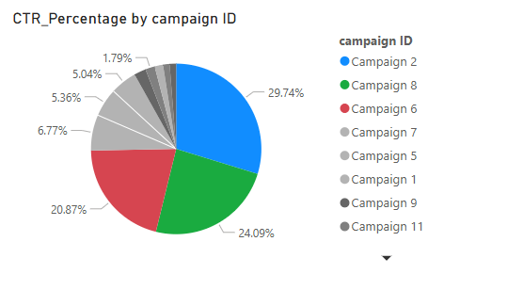
Recommendation for Campaign Discontinuation
(Analysis of CTR)
Blue = High CTR | Red = Low CTR
Increase budget for best-performing ads
Direct labels show CTR %
Shift budget from low performing campaigns to high CTR campaigns
10

Slide 11


CONCLUSION
Campaign 3 Performance
Recommendation for Campaign 3
Campaign 3 showed high Cost Per Result (CPR) and low Click-Through Rate (CTR), indicating poor engagement and inefficiency. The high costs suggest that the campaign is not delivering sufficient value relative to its expenses.
Due to its underperformance, discontinuation is recommended unless major adjustments can significantly improve efficiency. Reallocating the budget to better-performing campaigns could yield higher returns.
Campaign 10 Performance
Next Steps for Optimization
Campaign 10 had moderate CTR but a relatively high CPR, showing that while engagement exists, the cost of achieving results is still high. This suggests room for optimization rather than discontinuation.
To improve Campaign 10, targeting strategies, ad creatives, and bidding approaches should be refined. A/B testing different messages and placements, along with landing page enhancements, can help drive better engagement at a lower cost.
11

